Slide 1

BINARY CODES
20XC14 DIGITAL SYSTEM DESIGN

Slide 2
Lecture Outline
Binary Arithmetic Review
Extending Numeric Precision
Binary coded decimal

Slide 3
Binary Arithmetic Review
The following Binary pattern represents what signed number?
Given that the representation is sign and magnitude?
Given that the representation is 1’s complement?
Given that the representation is 2’s complement?
What is the difference between carry out and overflow?
How do we convert 143.2₅ to base 6 ?
10110
10110 = - 6
10110 = - 9
10110 = - 10

Slide 4
Binary Codes -Extending Precision
How do we increase the number of bits used to represent (in 2’s comp) a given number?
We don’t want to change the numeric value!!
Simply sign extend the number
i.e. replicate the sign bit again & again …
Example:
0011
1010
becomes 00000011
= +3 (in four bits)
= +3 (in eight bits)
becomes 11111010
= -6 (in four bits)
= -6 (in eight bits)

Slide 5
Binary Codes -Increasing Precision
Range of Integers (2’s complement representation)
An 8-bit unsigned integer?
A 16-bit unsigned integer?
A 32-bit unsigned integer?
An 8-bit signed integer?
A 16-bit signed integer?
A 32-bit signed integer?
0 to (2^{n} -1) = 0 to 255₁₀
0 to (2^{n} -1) = 0 to 65,535₁₀
0 to (2^{n} -1) = 0 to 4,294,967,295₁₀
-(2^{n-1}) to (2^{n-1} -1) = -128₁₀ to 127₁₀
-(2^{n-1}) to (2^{n-1} -1) = -32,768₁₀ to 32,767₁₀
-(2^{n-1}) to (2^{n-1} -1) = -2,147,483,648₁₀ to 2,147,483,647₁₀

Slide 6
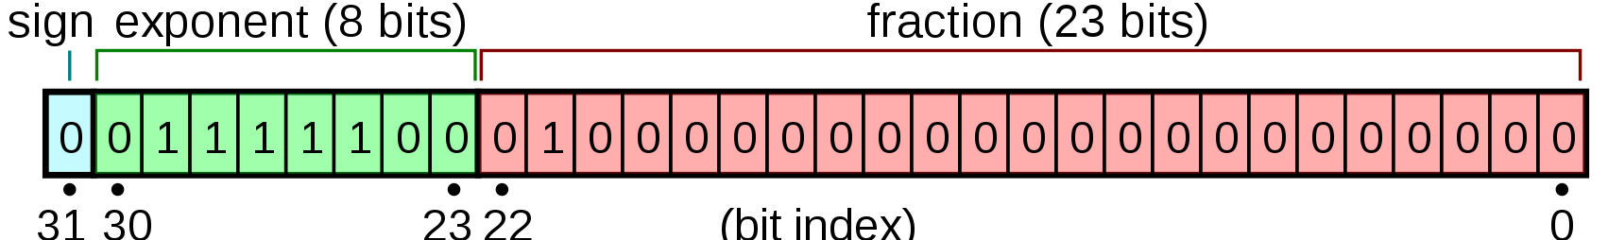
Binary Codes - Increasing Precision
Representation of Floating Point Numbers- Example of the IEEE 754 standard
Single precision 32 bit floating point format
For this example:
Sign = 0, hence, a positive number
Exponent = 124, hence,
Fraction = 1.0100…0₂= 1+0x2⁻¹+1x2⁻²+0x2⁻³+… = 1.25₁₀
Hence, the number is +1.25/8 = 0.15625₁₀
= 0.15625₁₀

Slide 7
Binary Codes Binary Coded Decimal (BCD)
Represent a decimal by encoding each individual digit in binary form
How many bits do we need to represent each digit?
Ten possible choices for each digit (i.e. 0 to 9)
An example of using the binary coded decimal representation (BCD)
Not a very efficient use of “bits” !!!
9 3 7 . 2 5
1001
0011
0111
⋅
0010
0101

Slide 8
Binary Codes-Weighted Codes
BCD is one example of a generalized “weighted” code:
Weights:
Binary digits:
In the case of BCD the weights are:
E.g.: 0110 = 8x0+4x1+2x1+1x0 = 6
BCD is referred to as a 8-4-2-1 weighted code
The codes 1010, 1011, 1100, 1101, 1110, and 1111 are unused
Decimal Digit | 8-4-2-1 Code (BCD)
0 | 0000
1 | 0001
2 | 0010
3 | 0011
4 | 0100
5 | 0101
6 | 0110
7 | 0111
8 | 1000
9 | 1001

Slide 9
Decimal and BCD
Decimal Digit | 8-4-2-1 Code (BCD)
0 | 0000
1 | 0001
2 | 0010
3 | 0011
4 | 0100
5 | 0101
6 | 0110
7 | 0111
8 | 1000
9 | 1001
The BCD is simply the 4 bit representation of the decimal digit.
For multiple digit base 10 numbers, each symbol is represented by its BCD digit
What happened to 6 digits not used?

Slide 10
BCD operation
Consider the following BCD operation
Decimal: Add 4 + 1
Covert to binary 0 1 0 0
And 0 0 0 1
Getting 0 1 0 1
Which is still a BCD representation of a decimal digit
A second example
3 0 0 1 1
+3 0 0 1 1
Getting 6 or 0 1 1 0
And in range and a BCD digit representation

Slide 11
And now
Consider 5 + 5
5 0 1 0 1
+5 0 1 0 1
giving 1 0 1 0 which is binary 10 but not a BCD digit!
What to do? ……Try adding 6??
Had 1010 and want to add 6 or 0110
so 1 0 1 0
plus 6 0 1 1 0
Giving 1 0 0 0 0
Or a carry out to the next binary digit, or if the binary in BCD, the next BCD digit.

Slide 12
Another carry example
Add 7 + 6
have 7 0 1 1 1
plus 6 0 1 1 0
Giving 1 1 0 1 and again out of range
Adding 6 0 1 1 0
Giving 1 0 0 1 1 so a 1 carries out to the next BCD digit
FINAL BCD answer 0001 0011 or 13₁₀

Slide 13
Multibit BCD
Had a carry to the
3rd BCD digit position
1
0 1 0 0 done done
0 0 0 1 0 0 0 1 0 0 1 0
0 1 1 0
Add the BCD for 417 to 195
Would expect to get 612
BCD setup - start with Least Significant Digit
0 1 0 0 0 0 0 1 0 1 1 1
0 0 0 1 1 0 0 1 0 1 0 1
1 1 0 0
Adding 6 0 1 1 0
Gives 1 0 0 1 0
Had a carry to the 2nd BCD digit position
1
0 1 0 0 0 0 0 1 done
0 0 0 1 1 0 0 1 0 0 1 0
1 0 1 1
Again + 6 0 1 1 0
Giving 1 0 0 0 1
And another carry

Slide 14
Multibit BCD
Had a carry to the
3rd BCD digit position
1
0 1 0 0 done done
0 0 0 1 0 0 0 1 0 0 1 0
0 1 1 0
Add the BCD for 417 to 195
Would expect to get 612
BCD setup - start with Least Significant Digit
0 1 0 0 0 0 0 1 0 1 1 1
0 0 0 1 1 0 0 1 0 1 0 1
1 1 0 0
Adding 6 0 1 1 0
Gives 1 0 0 1 0
Had a carry to the 2nd BCD digit position
1
0 1 0 0 0 0 0 1 done
0 0 0 1 1 0 0 1 0 0 1 0
1 0 1 1
Again + 6 0 1 1 0
Giving 1 0 0 0 1
And another carry
And answer is 0110 0001 0010 or the BCD for the base 10 number 612

Slide 15
Binary Codes-Other Weighted Codes
6-3-1-1 Code
Example:
Encode 4 via a 6-3-1-1 code;
Hence, 4 = 0101 as a 6-3-1-1 code
Also, 4 = 0110 as a 6-3-1-1 code
Decimal Digit | 6-3-1-1 Code
0 | 0000
1 | 0001
2 | 0011
3 | 0100
4 | 0101
5 | 0111
6 | 1000
7 | 1001
8 | 1011
9 | 1100
The 6-3-1-1 encoding is not unique !!

Slide 16
Binary Codes -Weighted Codes
Decimal Digit | 8-4-2-1 Code (BCD)
0 | 0000
1 | 0001
2 | 0010
3 | 0011
4 | 0100
5 | 0101
6 | 0110
7 | 0111
8 | 1000
9 | 1001
Other Weighted Codes
Excess-3 Code: BDC + 3
Excess-3 Code
0011
0100
0101
0110
0111
1000
1001
1010
1011
1100
+3=

Slide 17
Binary Codes -Weighted Codes
Other Weighted Codes
2-out-of-5 Code
Two out of 5 bits are 1’s for every decimal digit
Decimal Digit | 2-out-of-5 Code
0 | 00011
1 | 00101
2 | 00110
3 | 01001
4 | 01010
5 | 01100
6 | 10001
7 | 10010
8 | 10100
9 | 11000

Slide 18
Binary Codes -Binary Codes: Examples
What does 1110 0110 represent in a 5-2-2-1 weighted code?
What does 1000 0110 represent in a BCD (i.e. 8-4-2-1) weighted code?
Express 4 9 in excess-3 code
5+2+2+0=9
0+2+2+0=4
ANS: 9 4
8+0+0+0=8
0+4+2+0=6
ANS: 8 6
4 = 0100 + 0011 = 0111
9=1001+0011=1100
ANS: 0111 1100

Slide 19
Binary Codes -Weighted Codes
Other Weighted Codes
Gray Code
Codes for successive decimal digits differ by exactly one bit
Decimal Digit | Gray Code
0 | 0000
1 | 0001
2 | 0011
3 | 0010
4 | 0110
5 | 1110
6 | 1010
7 | 1011
8 | 1001
9 | 1000

Slide 20
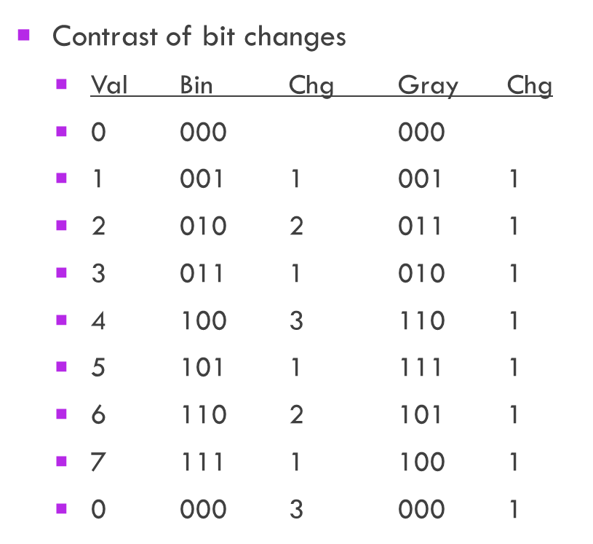
Gray Codes
When you count up or down in binary, the number of bit that change with each digit change varies.
From 0 to 1 just have a single but
From 1 to 2 have 2 bits, a 1 to 0 transition and a 0 to 1 transition
From 7 to 8 have 3 bits changing back to 0 and 1 bit changing to a 1
For some applications multiple bit changes cause significant problems.

Slide 21
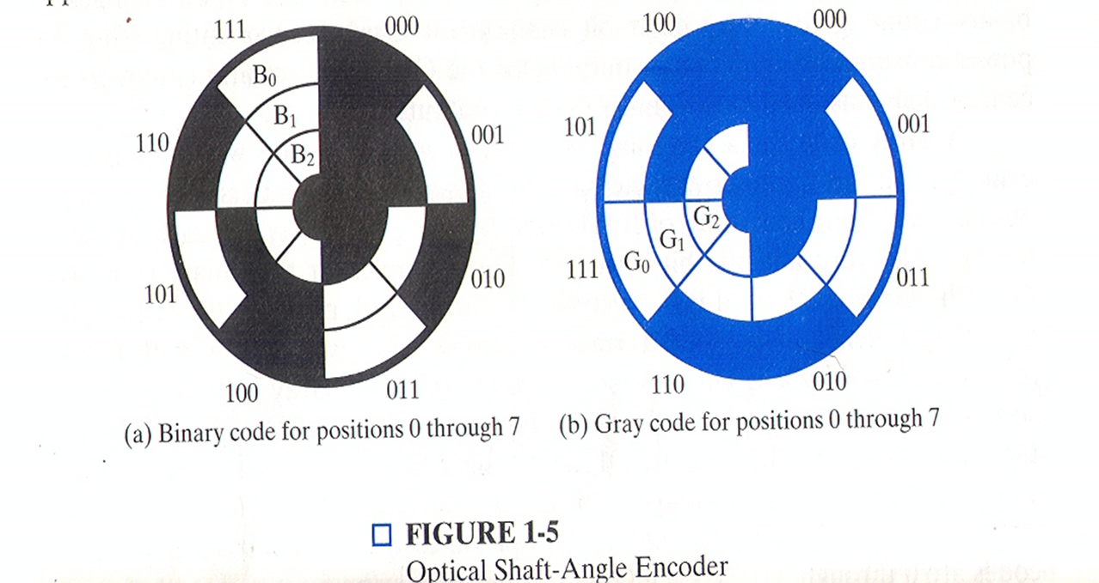
Gray Code
Contrast of bit changes
Val Bin Chg Gray Chg
0 000 000
1 001 1 001 1
2 010 2 011 1
3 011 1 010 1
4 100 3 110 1
5 101 1 111 1
6 110 2 101 1
7 111 1 100 1
0 000 3 000 1

Slide 22
Advantages of gray codes
The main advantage is power consumption is very less
useful in circuits that are sensitive to glitche
Gray code encoder output is commonly used in high speed applications or those with large amounts of signal noise resulting in missing signal data when reading binary data. Absolute encoders with gray code are available for point to point communication protocols including parallel and SSI.
It is also used for asynchronous fifo pointer.
Used for high speed decode circuit.
When Gray code are used in computers to address program memory , the computer uses less power because fever address line change as the program counter advances.
Gray code also play a vital role in error correction.

Slide 23
Gray Code
In pure binary coding or 8421 BCD then counting from 7 (0111) to 8 (1000) requires 4 bits to be changed simultaneously.
Gray coding avoids this since only one bit changes between subsequent numbers
Gray code eliminates errors

Slide 24
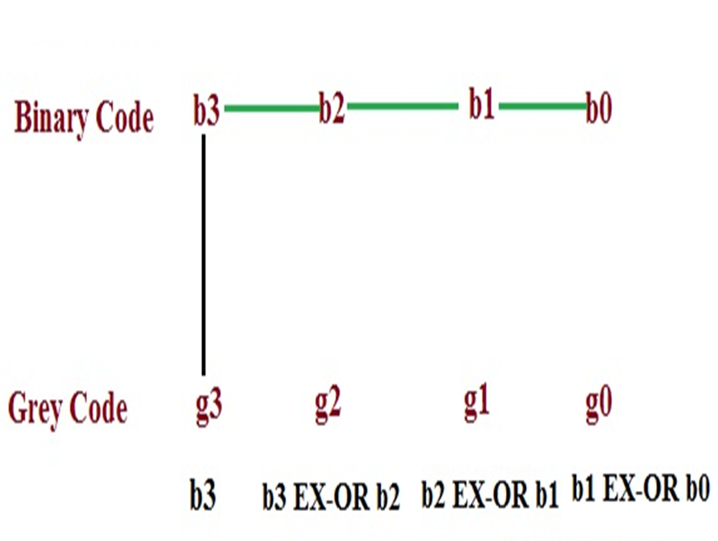
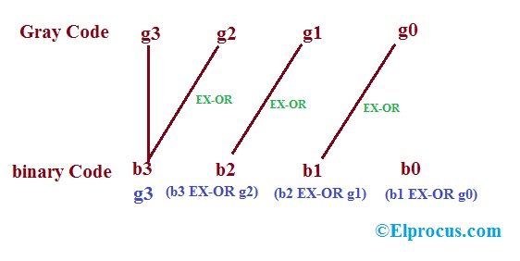
Binary to Gray Conversion
Gray to Binary Conversion

Slide 25
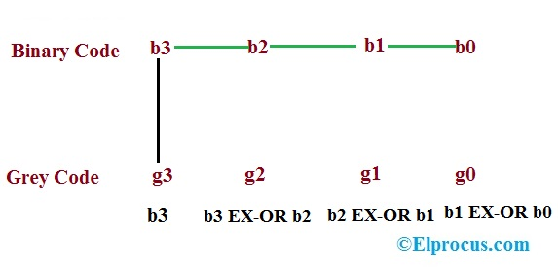
Binary –to-Gray Code Conversion

Slide 26
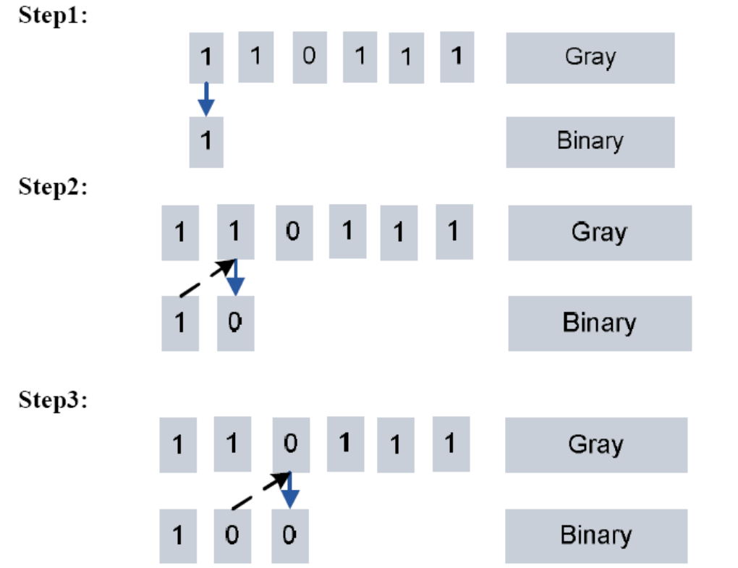
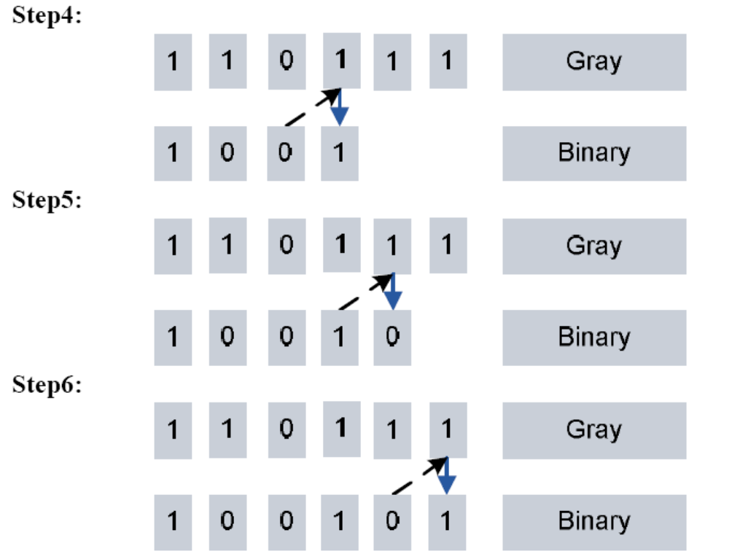
Gray –to-Binary Conversion

Slide 27
Binary Codes -Various Codes
Decimal Digit | 8-4-2-1 Code (BCD) | 6-3-1-1 Code | Excess-3 Code | 2-out-of-5 Code | Gray Code
0 | 0000 | 0000 | 0011 | 00011 | 0000
1 | 0001 | 0001 | 0100 | 00101 | 0001
2 | 0010 | 0011 | 0101 | 00110 | 0011
3 | 0011 | 0100 | 0110 | 01001 | 0010
4 | 0100 | 0101 | 0111 | 01010 | 0110
5 | 0101 | 0111 | 1000 | 01100 | 1110
6 | 0110 | 1000 | 1001 | 10001 | 1010
7 | 0111 | 1001 | 1010 | 10010 | 1011
8 | 1000 | 1011 | 1011 | 10100 | 1001
9 | 1001 | 1100 | 1100 | 11000 | 1000

Slide 28
Alphanumeric Codes
How do you handle alphanumeric data?
Easy answer!
Formulate a binary code to represent characters! ☺
For the 26 letter of the alphabet would need 5 bit for representation.
But what about the upper case and lower case, and the digits, and special characters

Slide 29
A code called ASCII
ASCII stands for American Standard Code for Information Interchange
The code uses 7 bits to encode 128 unique characters
Reference the textbook, pg. 27, for a table of the ASCII code
As a note, formally, work to create this code began in 1960. 1st standard in 1963. Last updated in 1986.

Slide 30
ASCII Code
Represents the numbers
All start 011 xxxx and the xxxx is the BCD for the digit
Represent the characters of the alphabet
Start with either 100, 101, 110, or 111
A few special characters are in this area
Start with 010 – space and !”#$%&’()*+.-,/
Start with 000 or 001 – control char like ESC

Slide 31
ASCII Example
Encoding of 123
011 0001 011 0010 011 0011
Encoding of Joanne
100 1010 110 1111 110 0001 110 1110 110 1110 110 0101
Note that these are 7 bit codes

Slide 32
What to do with the 8th Bit?
In digital systems data is usually organized as bytes or 8 bit of data.
How about using the 8th bit for an error coding. This would help during data transmission, etc.
Parity bit – the extra bit included to make the total number of 1s in the byte either even or odd – called even parity and odd parity

Slide 33
Example of Parity
Consider data 100 0001
Even Parity 0100 0001
Odd Parity 1100 0001
Consider data 1010100
Even Parity 1101 0100
Odd Parity 0101 0100
A parity code can be used for ASCII characters and any binary data.

Slide 34
ASCII Codes

Slide 35
Other Character Codes
A long time ago, there existed cards, called punch cards!
And a code for those cards called Hollerith code. (patented in 1889)
The code told you what character was being represented in a column when there was a punch out in various rows of that column.
And another code for characters called EBCDIC (Extended Binary Coded Decimal Interchange Code) (1963, 1964 IBM) - similar to ASCII –
Digits are coded F0 through F9 in EBCDIC

